Slide 1
SOID Principles

Slide 2
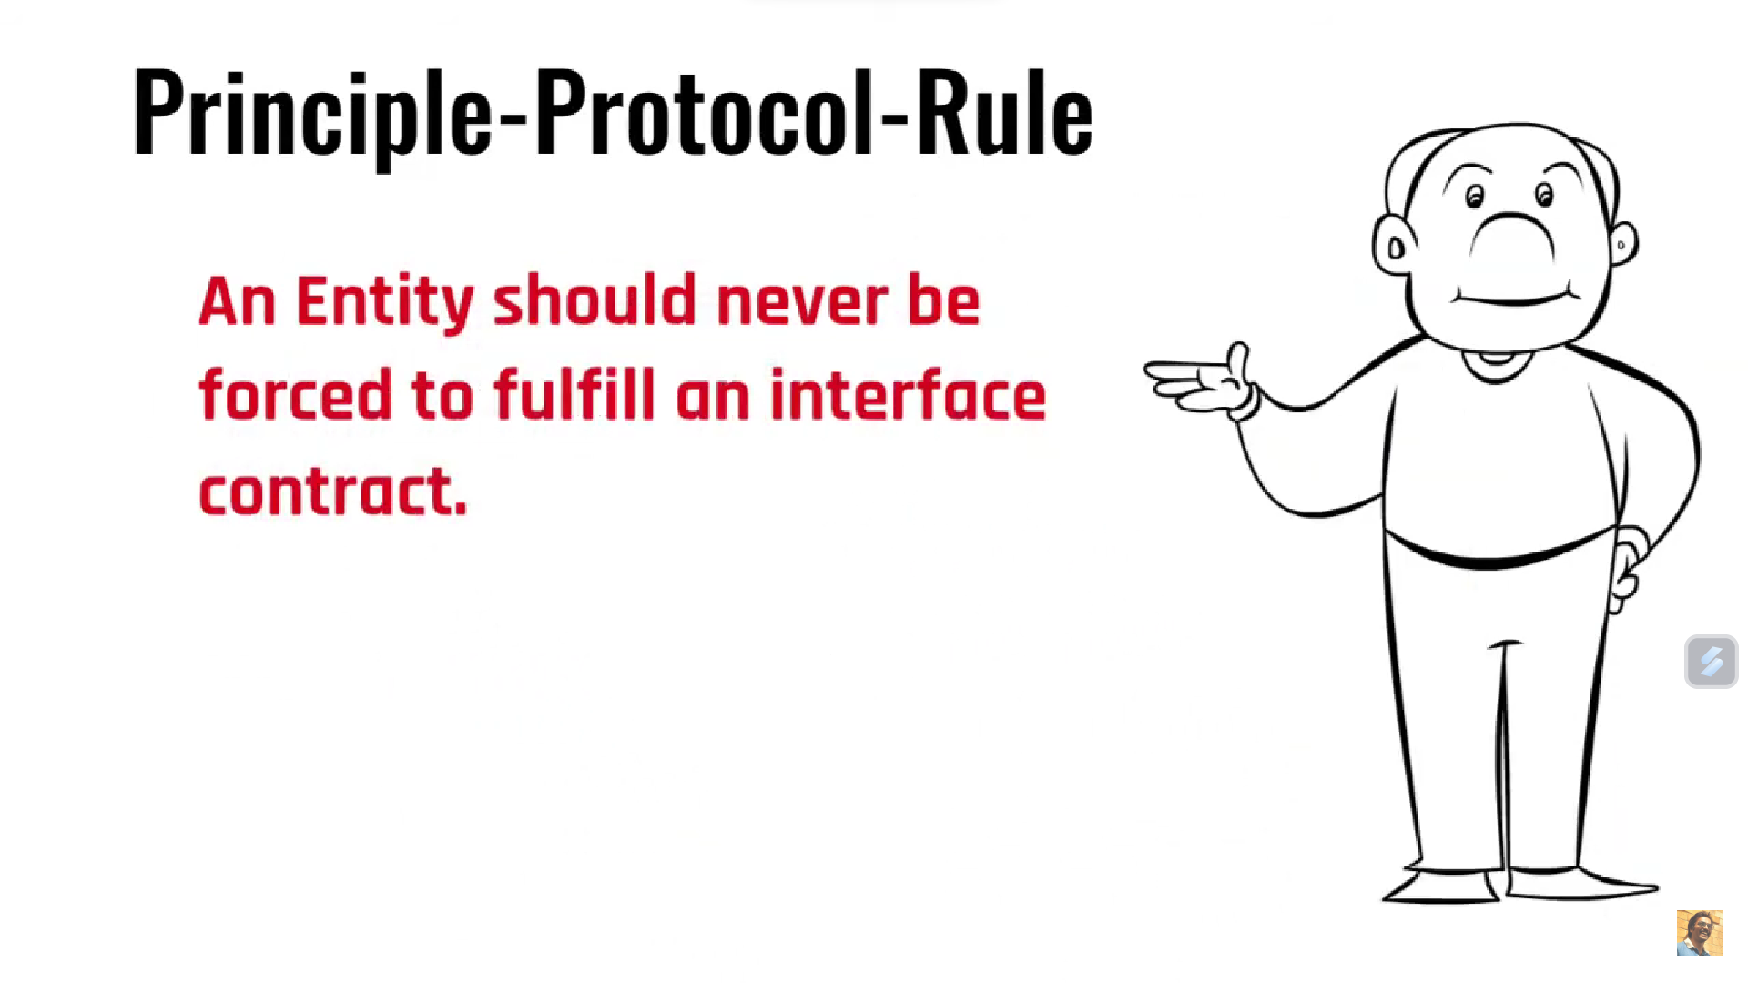
Interface Segregation

Slide 3
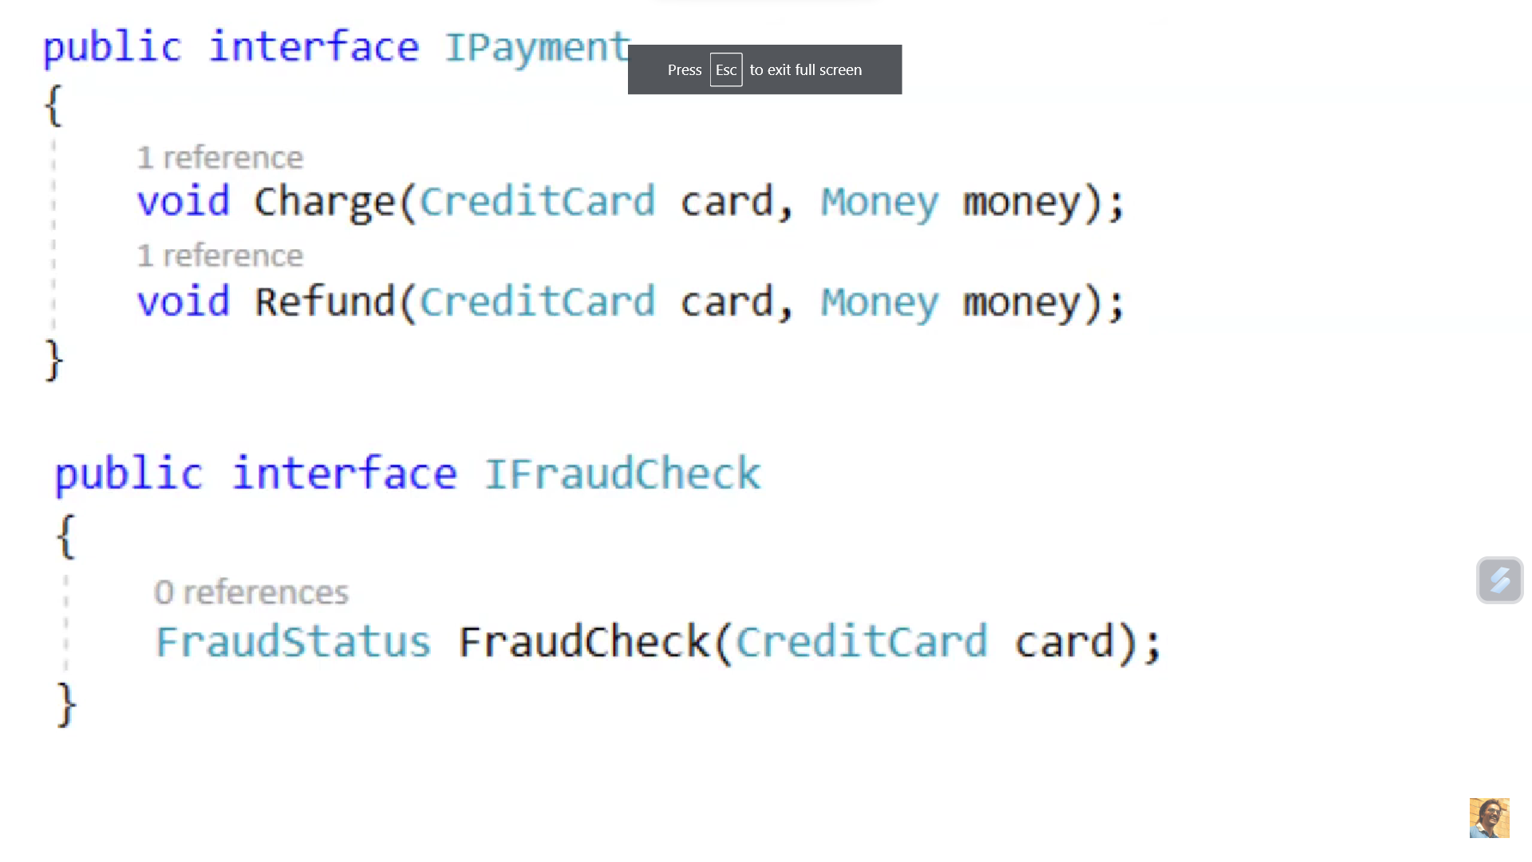
Interface Segregation

Slide 4
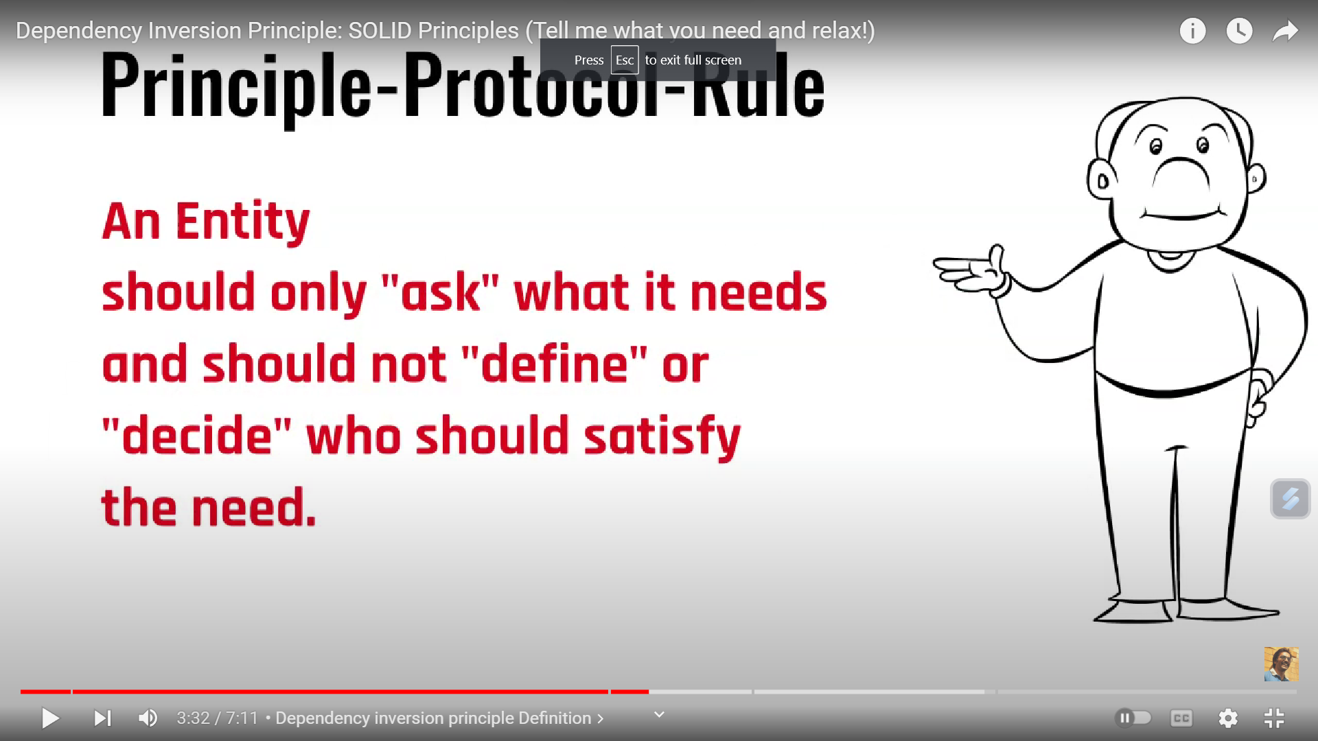
Interface Segregation

Slide 5
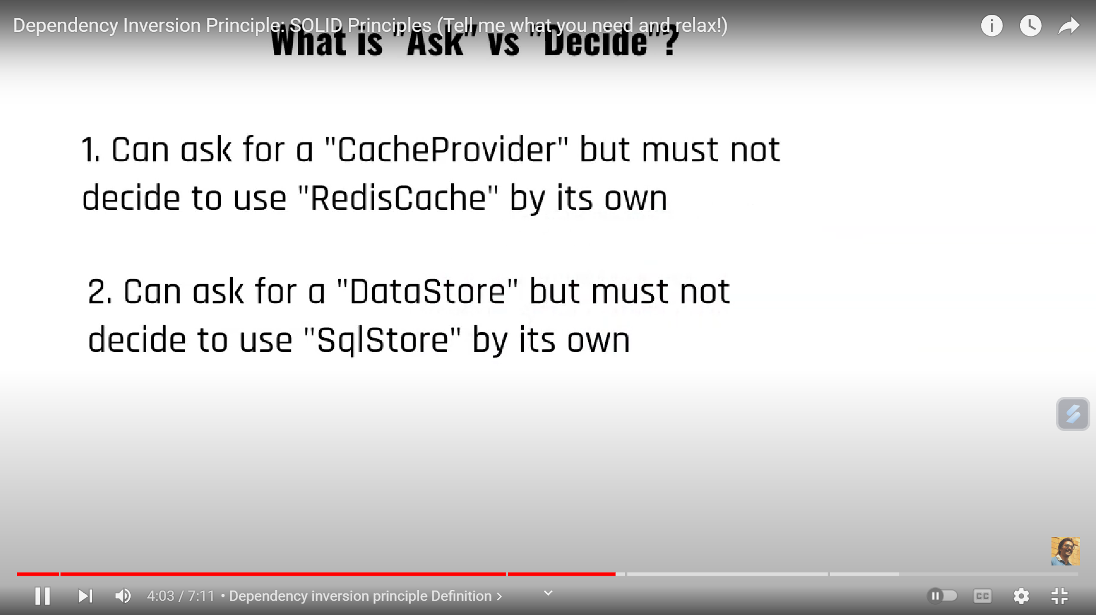
Interface Segregation

Slide 6
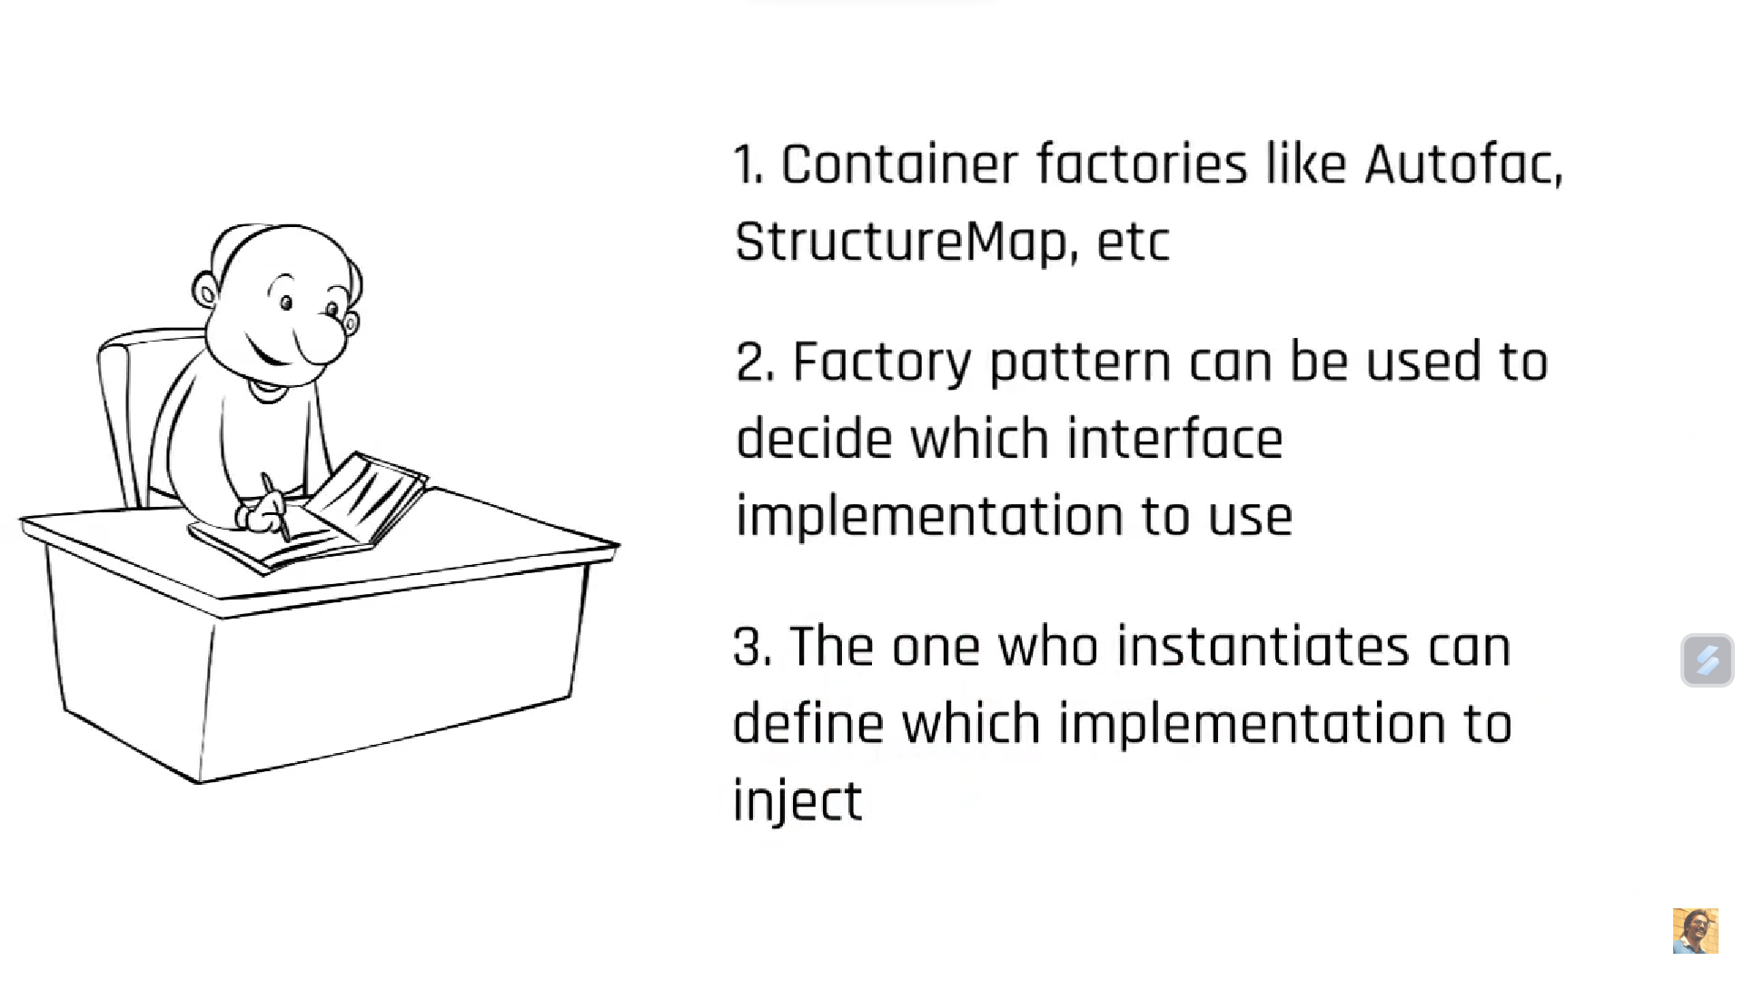
Interface Segregation

Slide 7
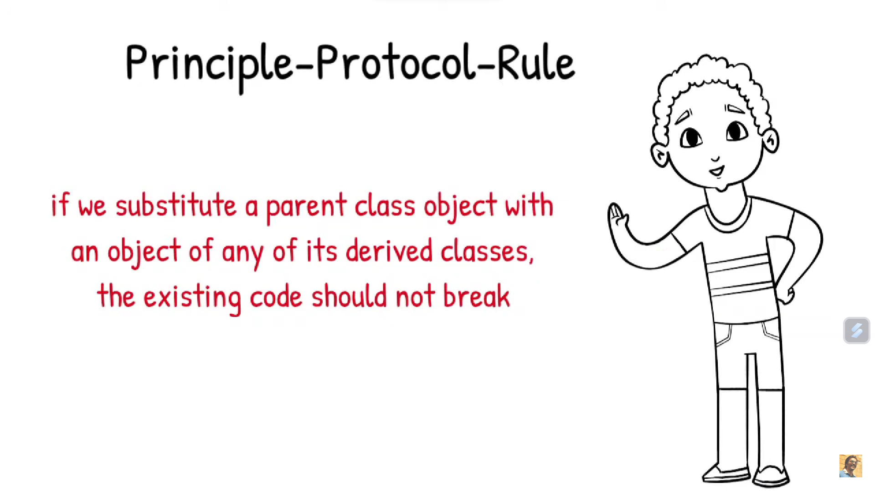
Interface Segregation
Liskov Substitution Principle

Slide 8
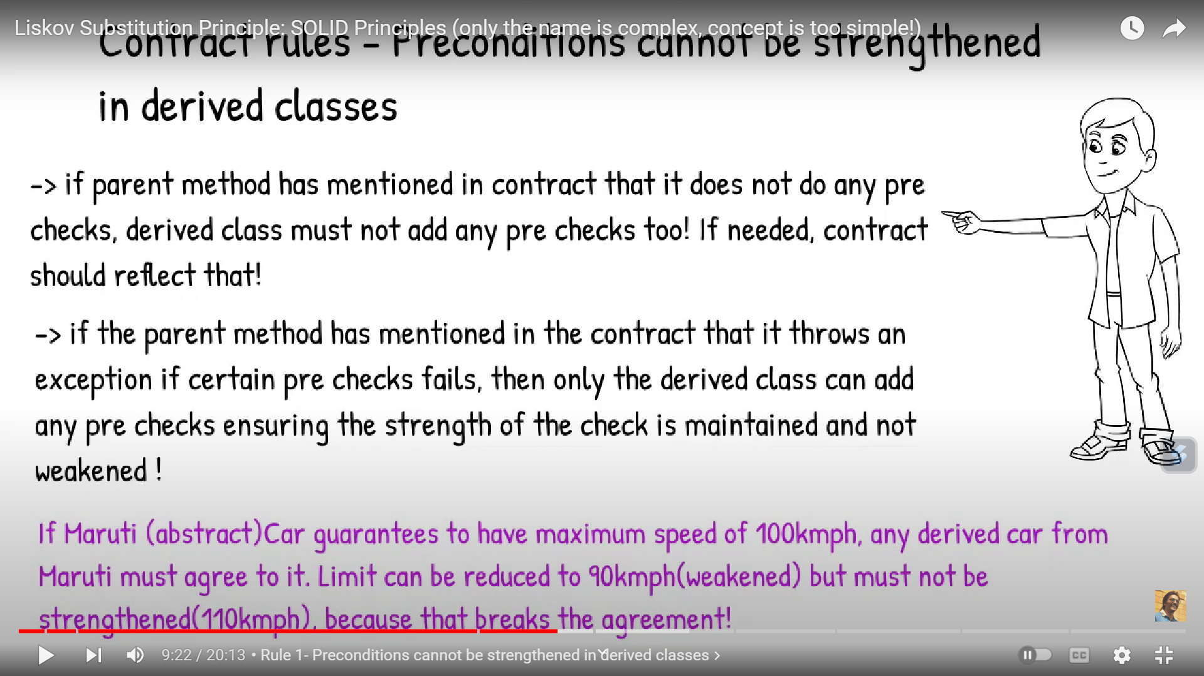
Interface Segregation

Slide 9
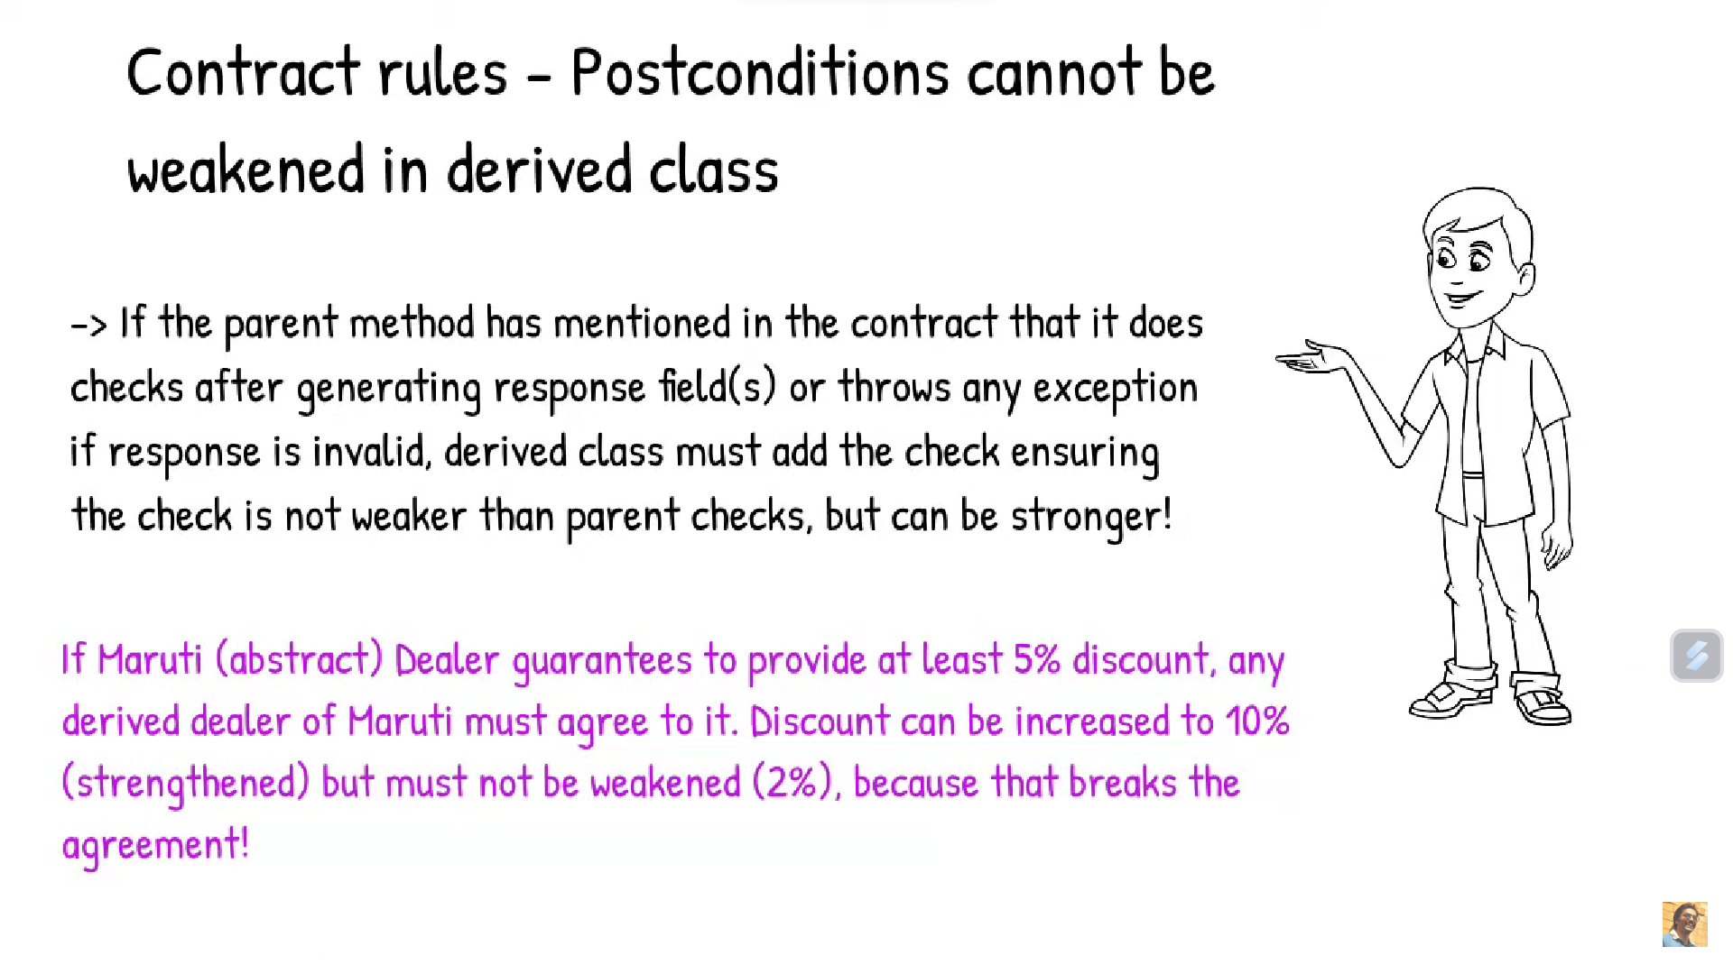
Interface Segregation

Slide 10
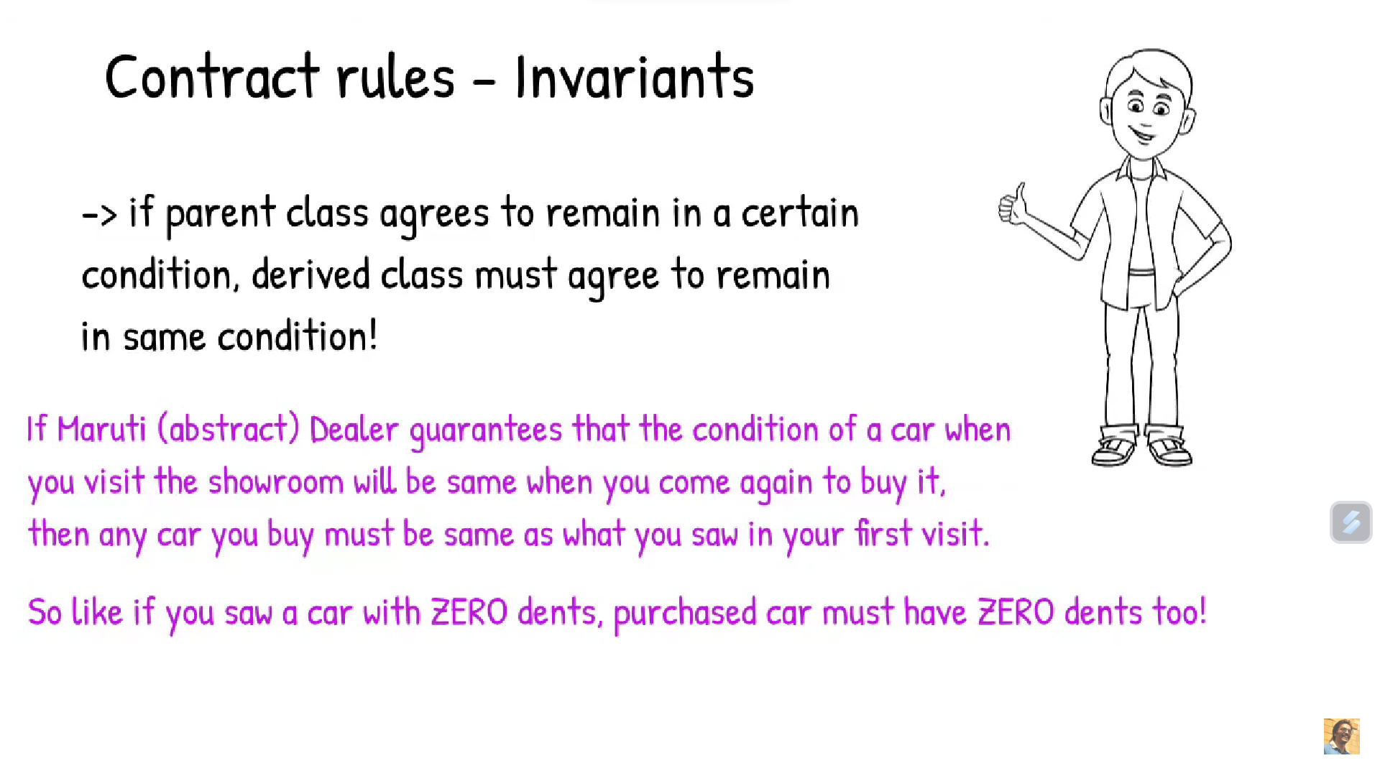
Interface Segregation

Slide 11
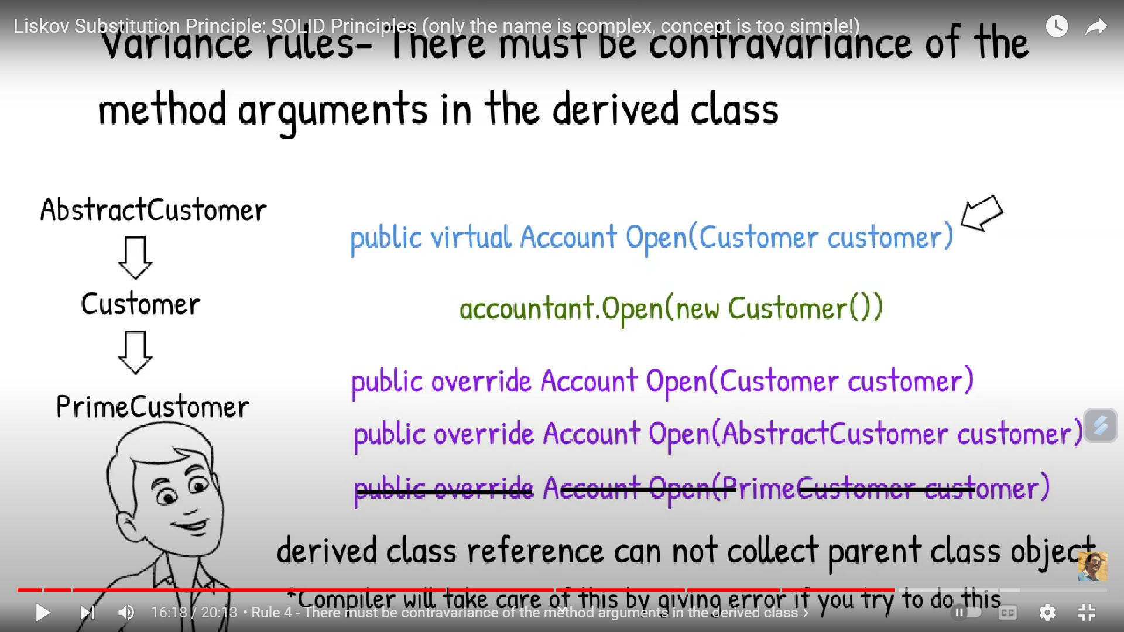
Interface Segregation

Slide 12
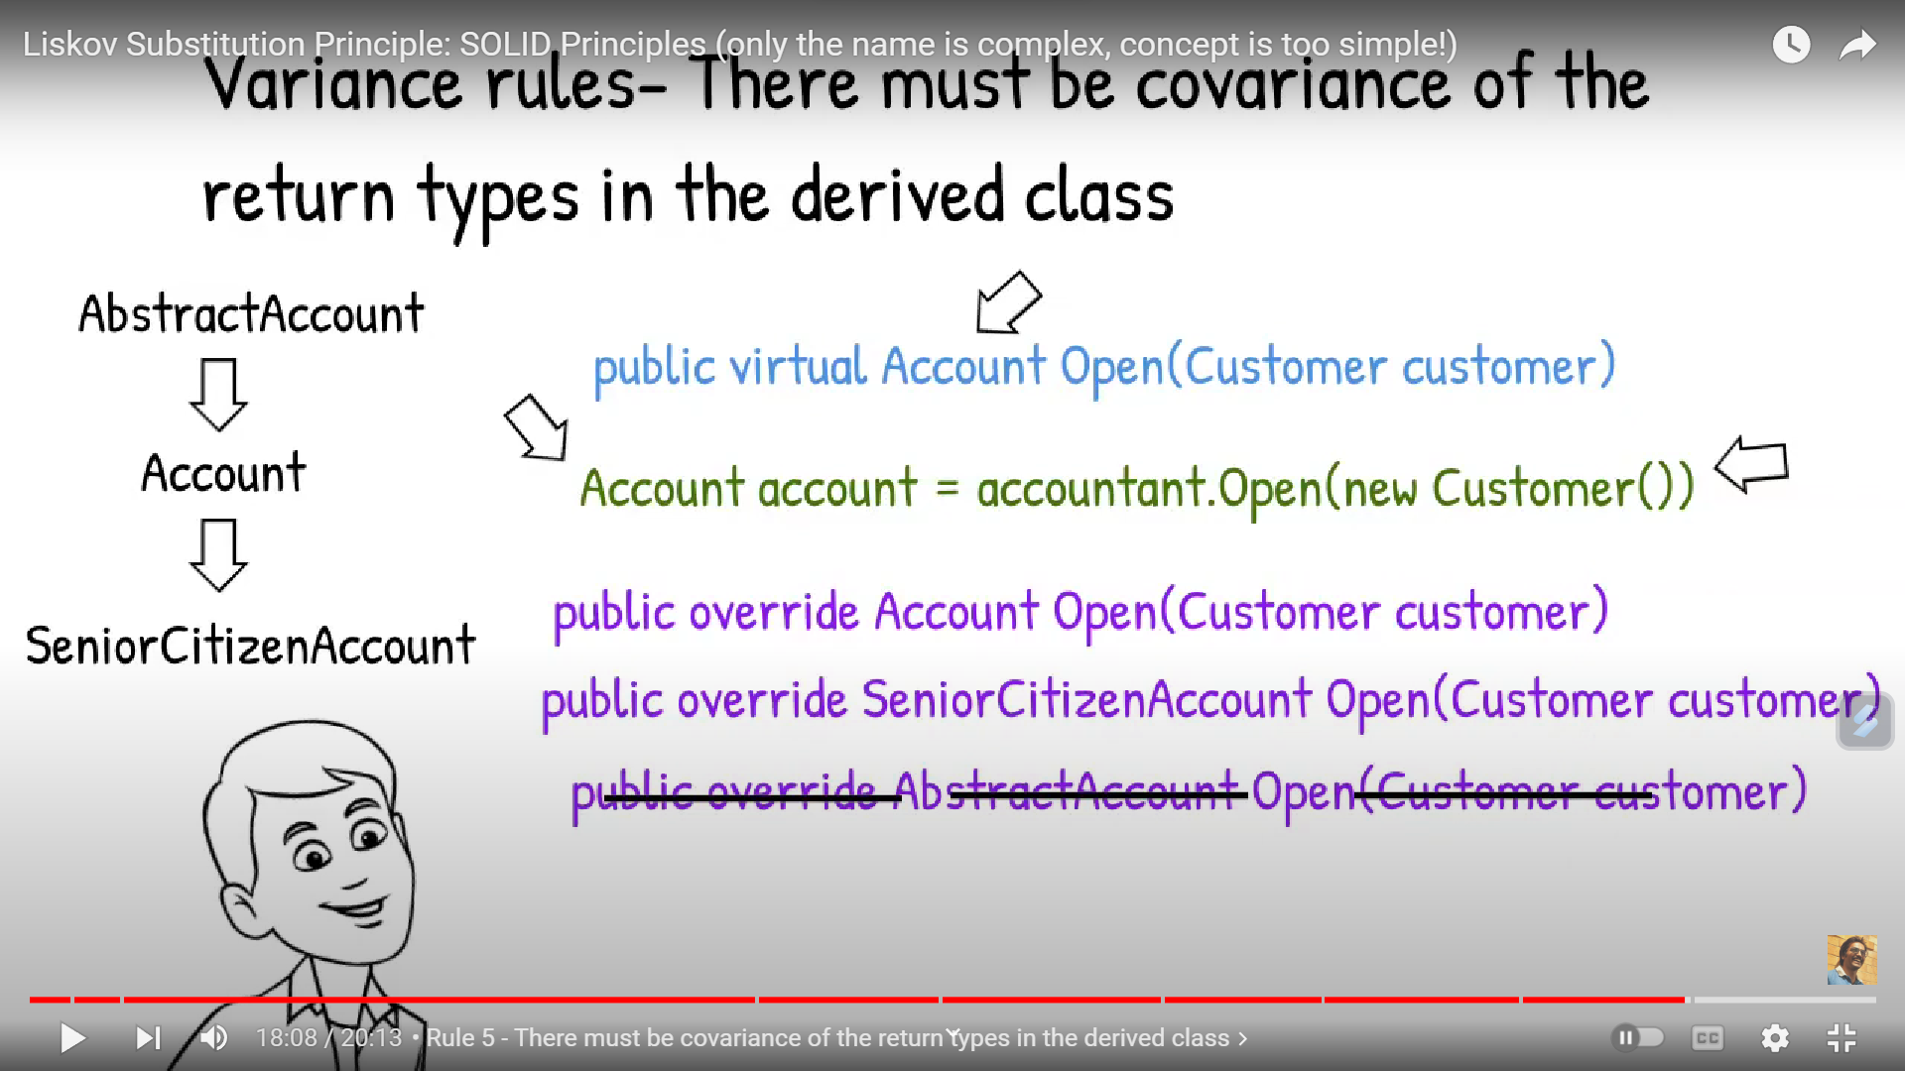
Interface Segregation

Slide 13
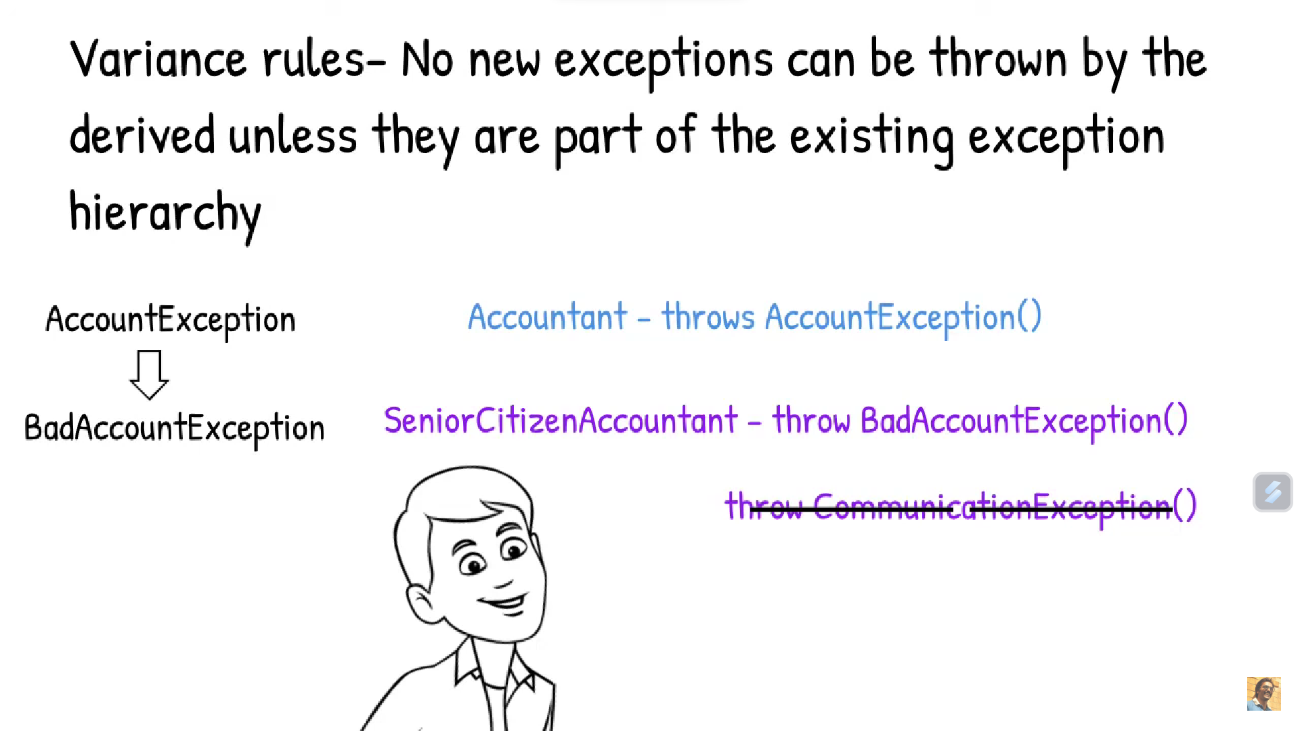
Interface Segregation

Slide 14
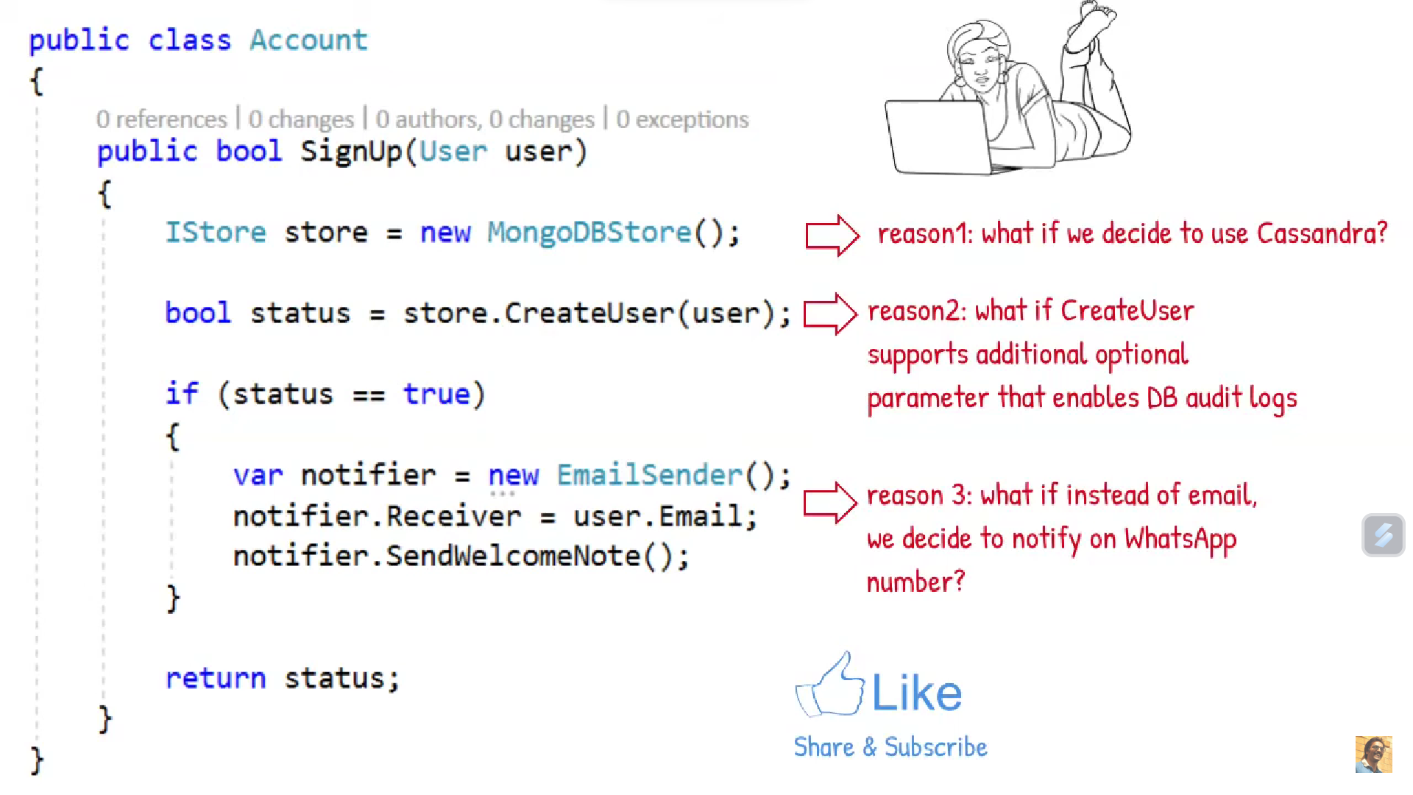
Interface Segregation
Single responsibility Principle

Slide 15
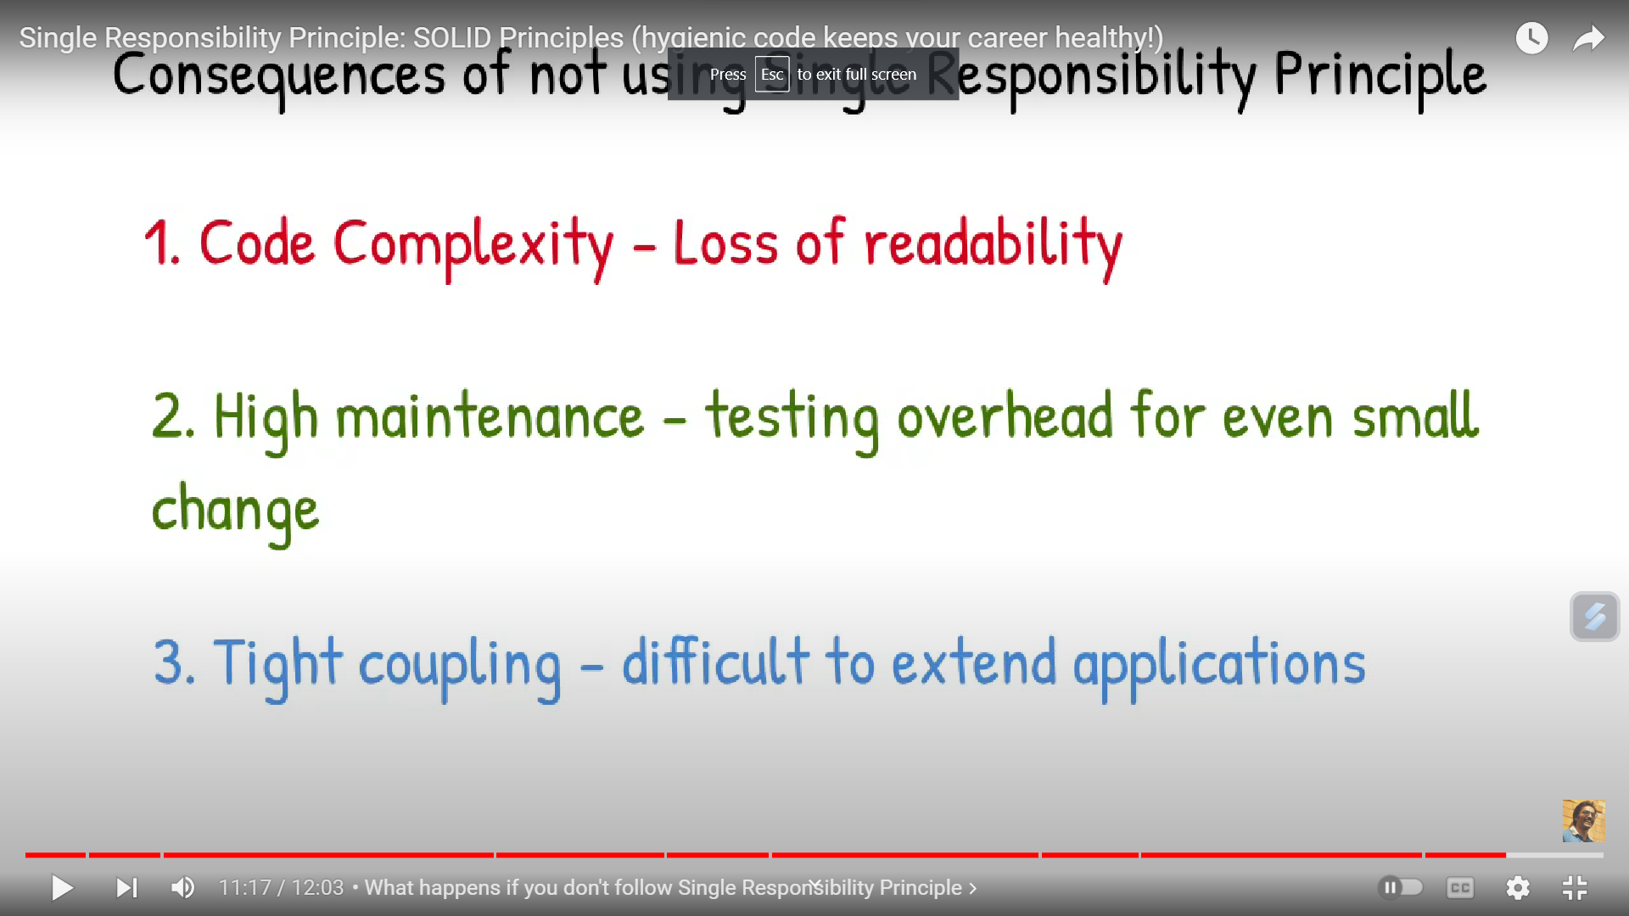
Interface Segregation
Single responsibility Principle

Slide 16
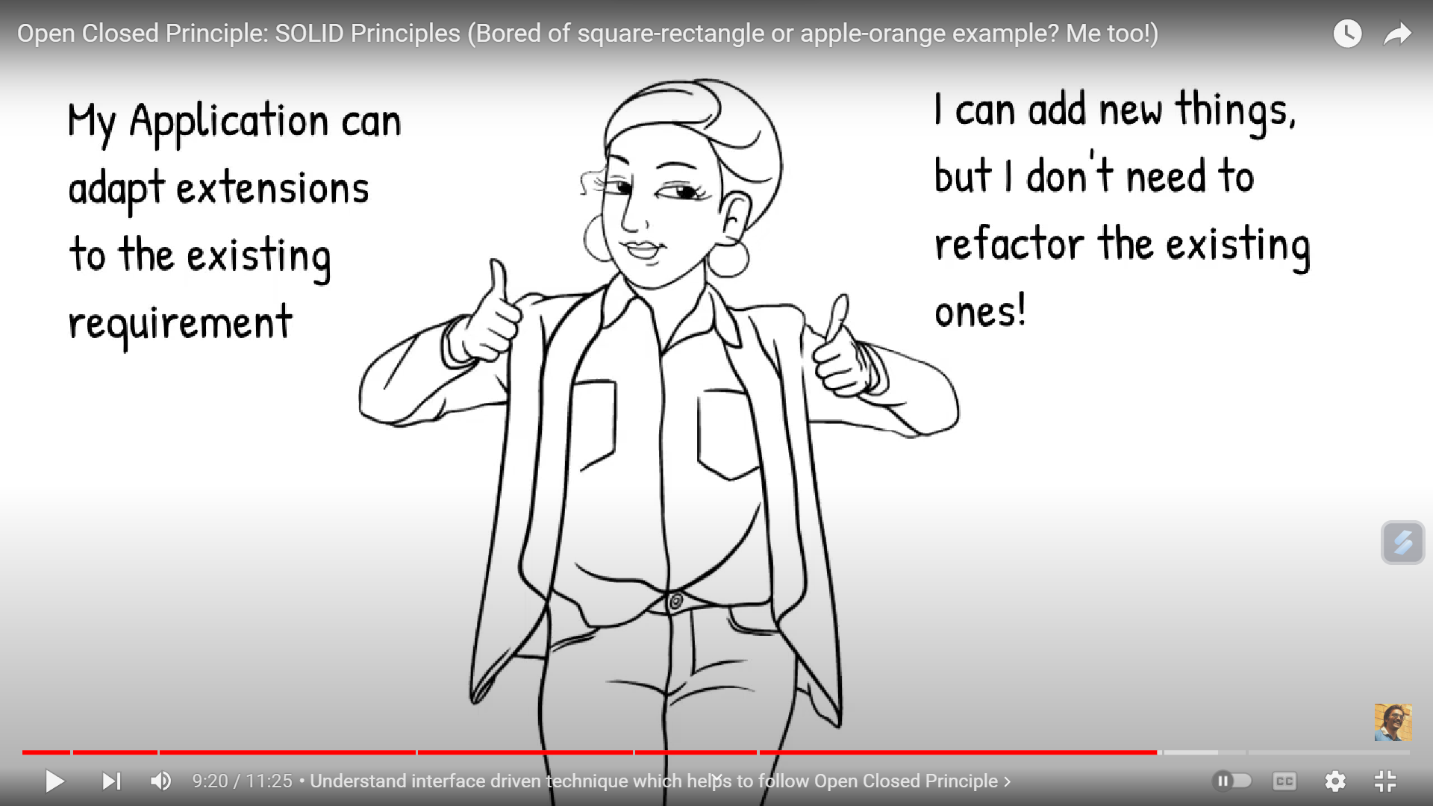
Open Close Principle: Open for extension closed for modification

Slide 17
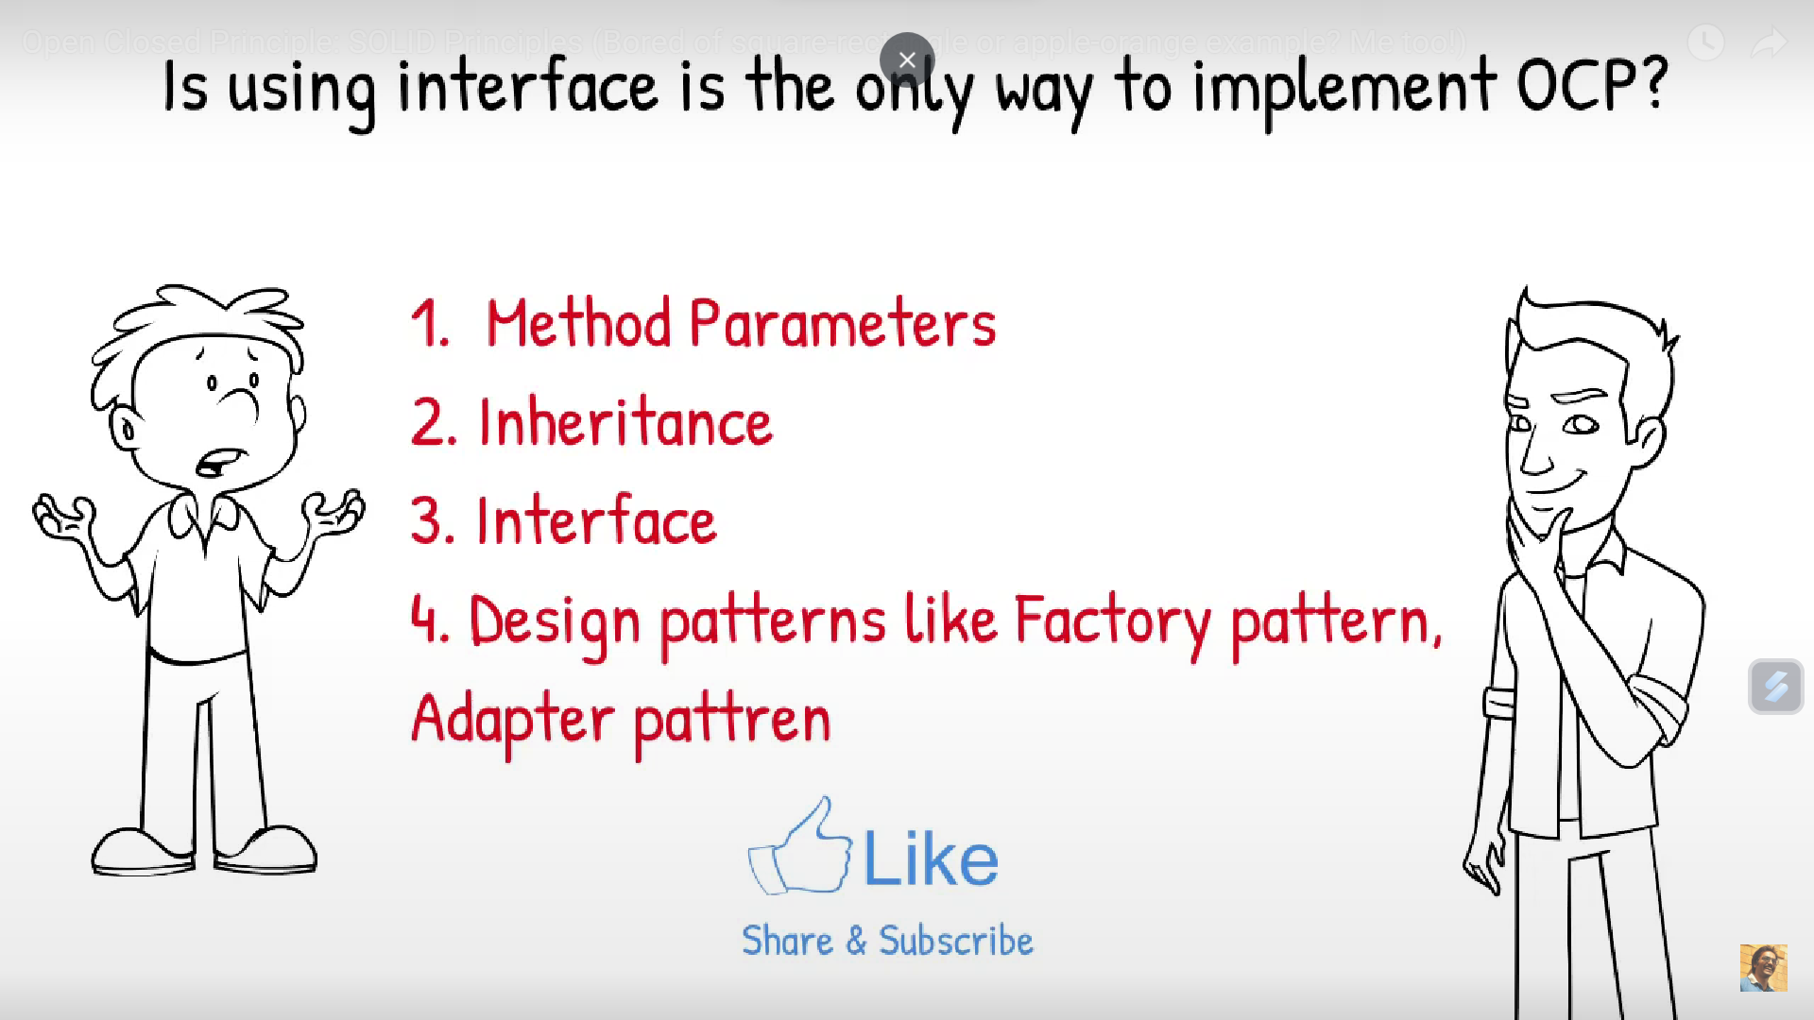
Open Close Principle: Open for extension closed for modification

Slide 18
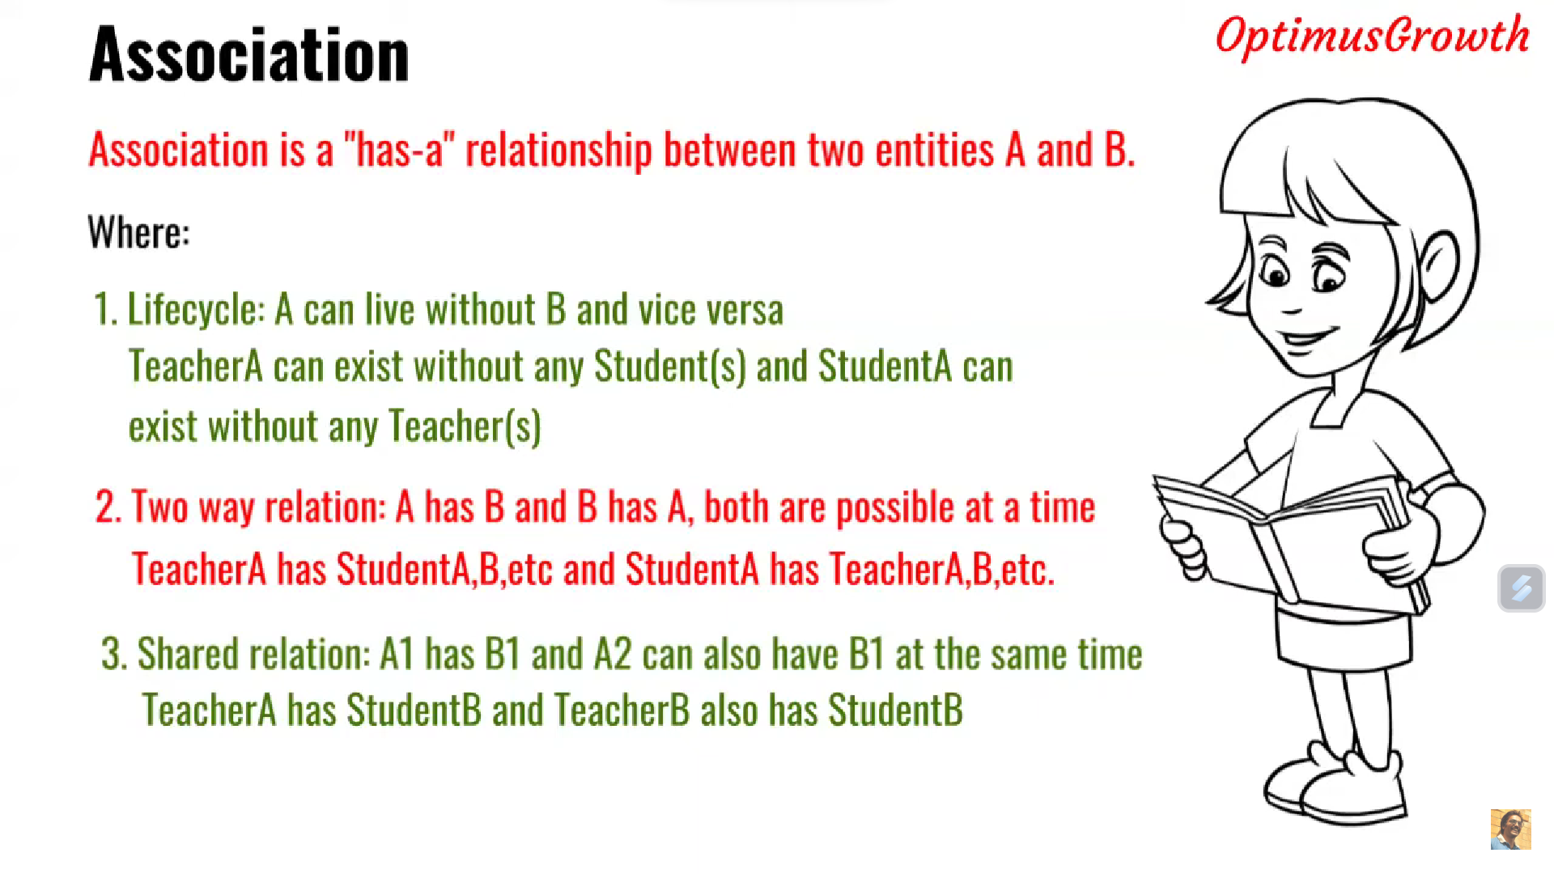
Open Close Principle: Open for extension closed for modification

Slide 19
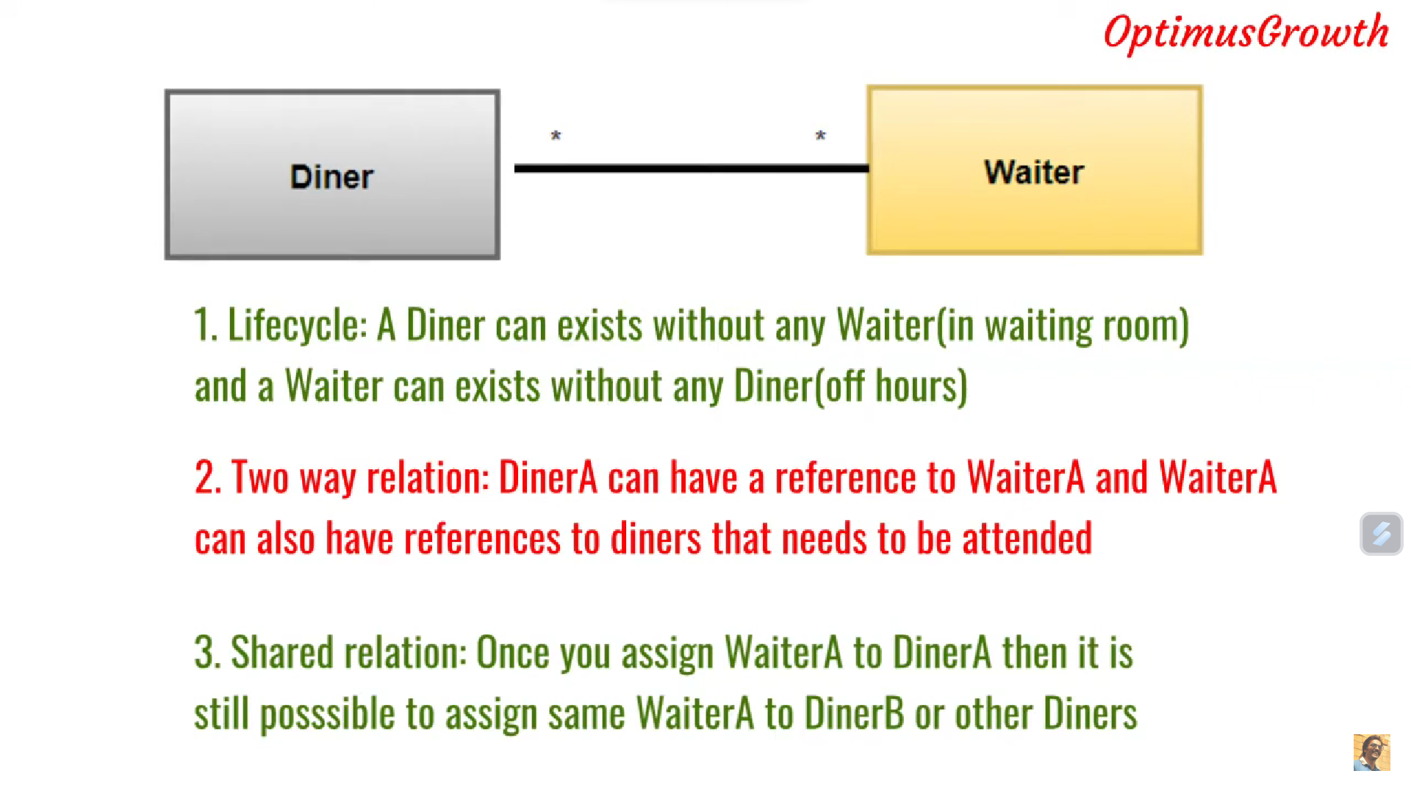
Open Close Principle: Open for extension closed for modification

Slide 20
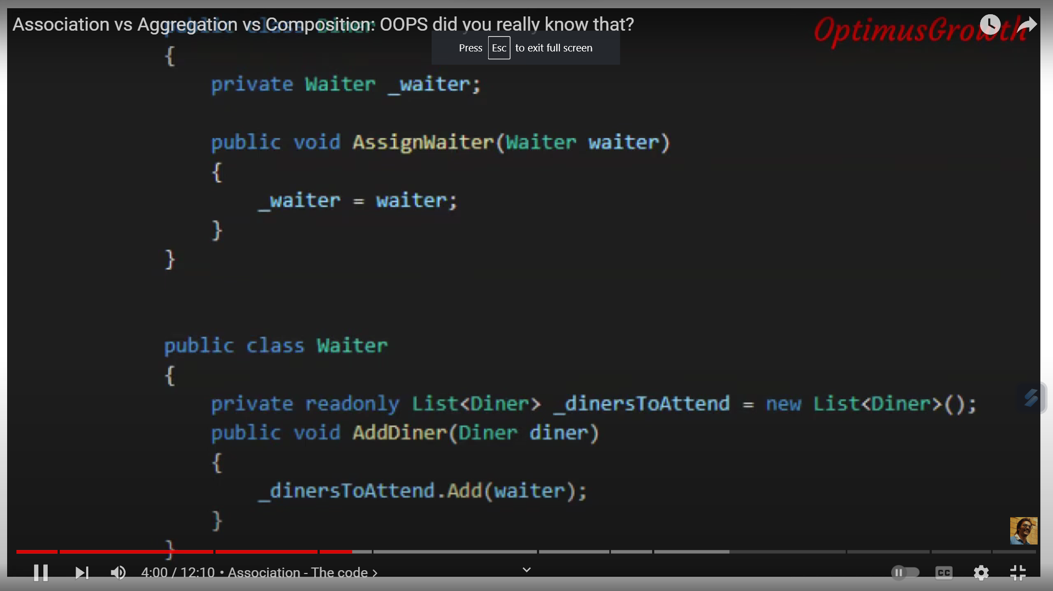
Open Close Principle: Open for extension closed for modification

Slide 21
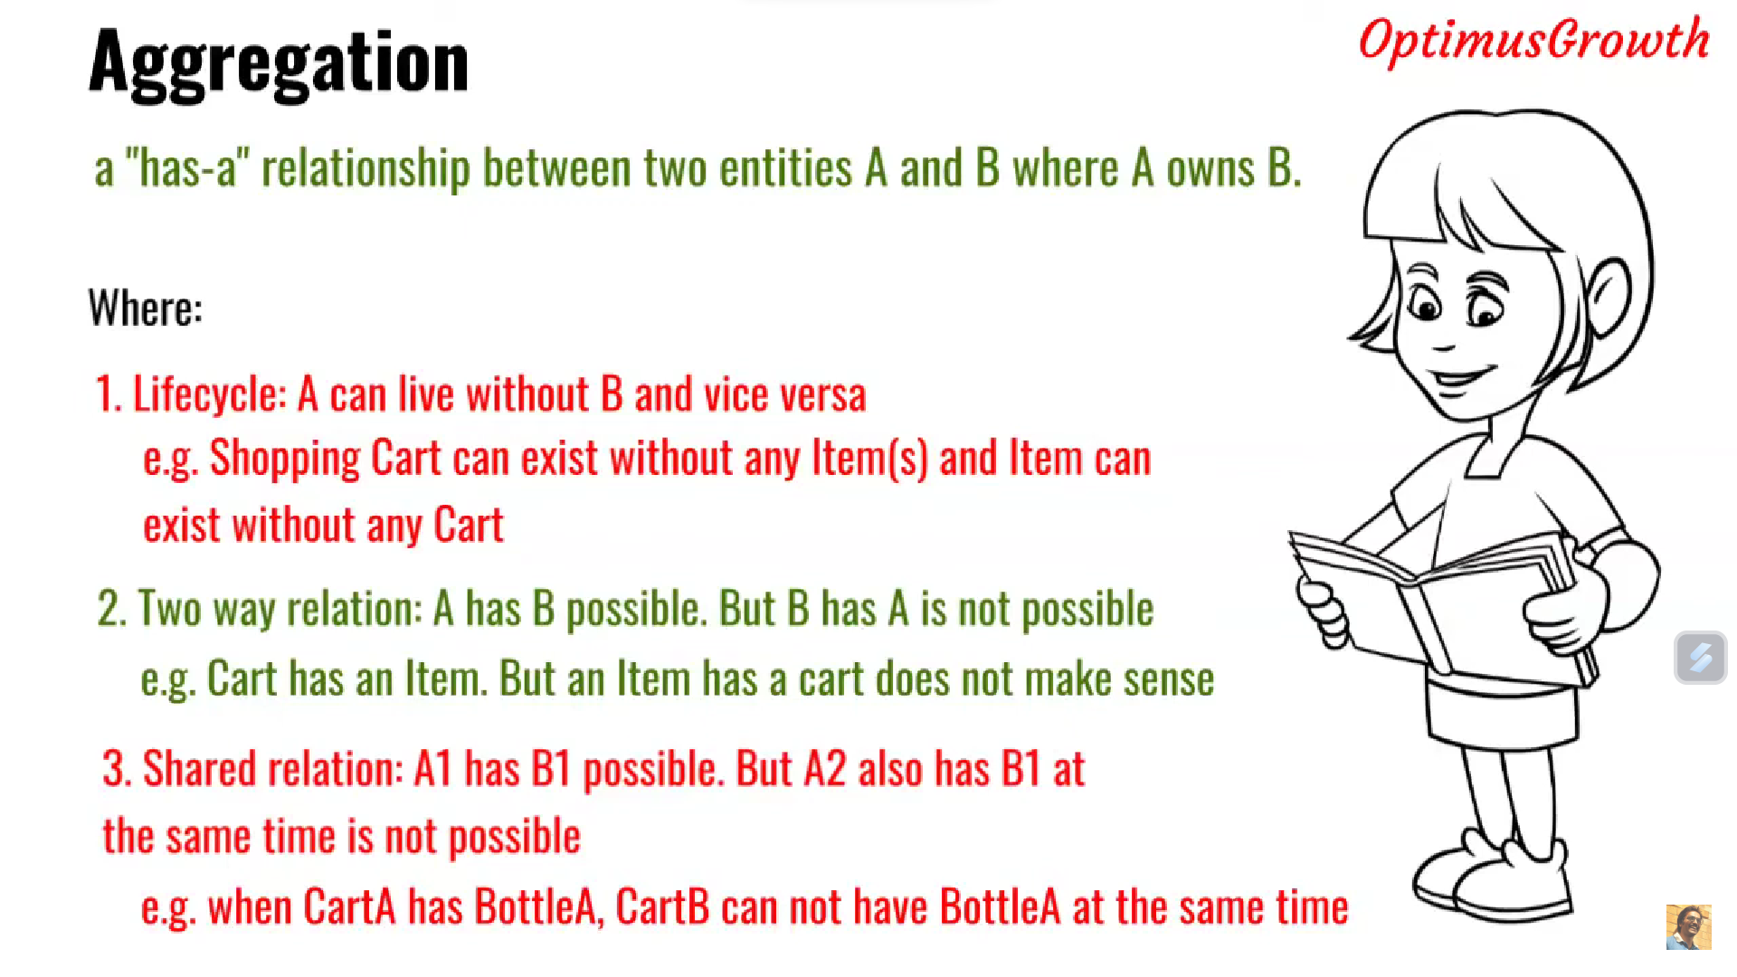
Open Close Principle: Open for extension closed for modification

Slide 22
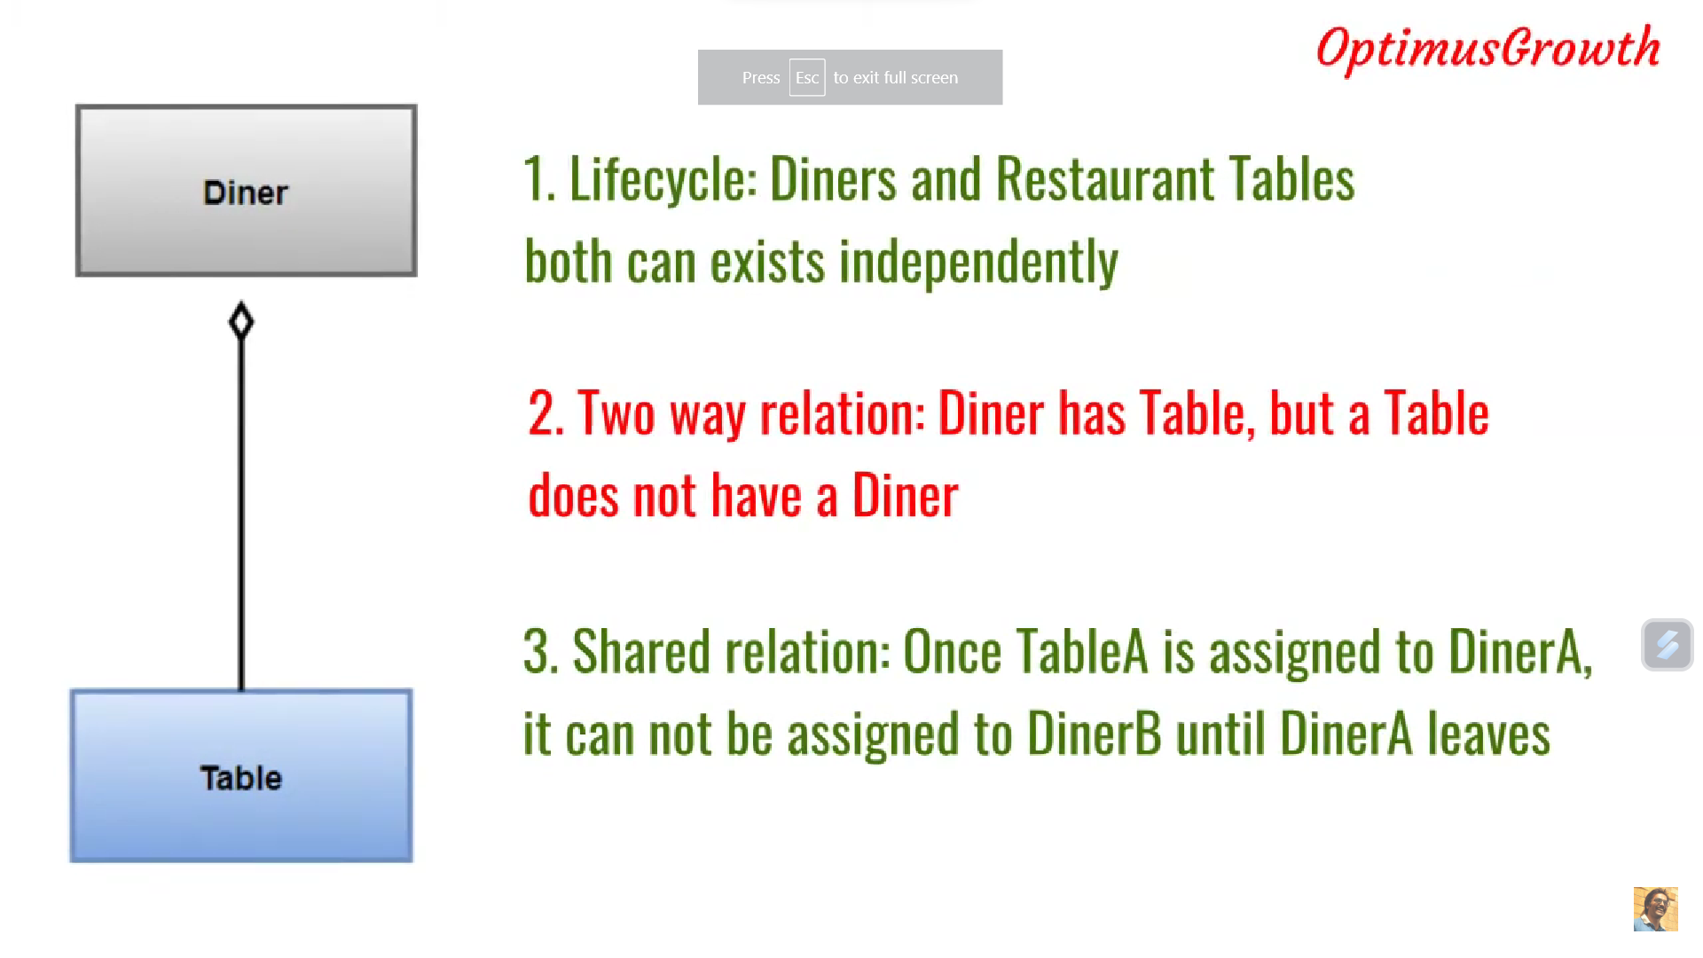
Open Close Principle: Open for extension closed for modification

Slide 23
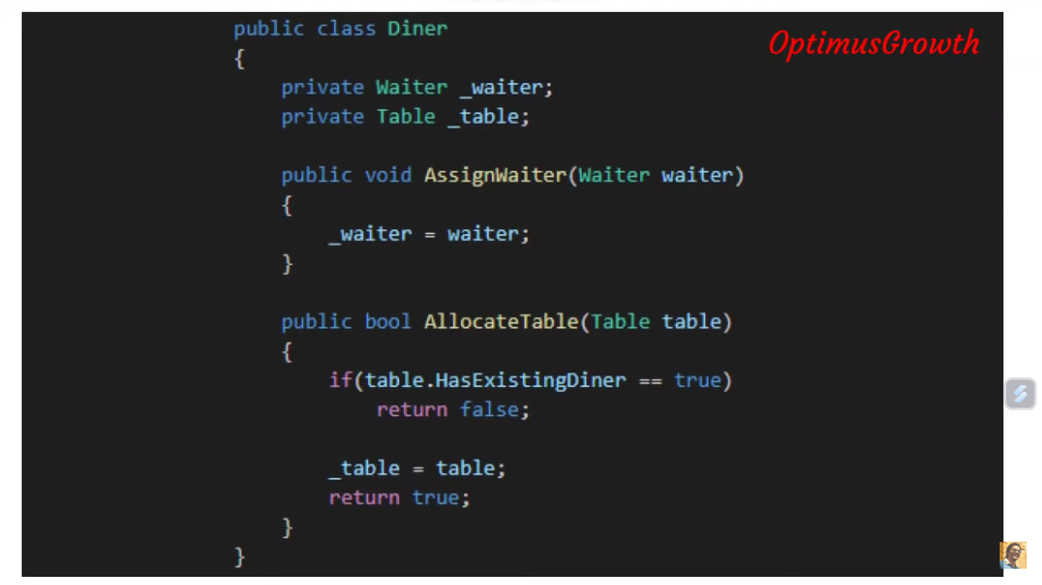
Open Close Principle: Open for extension closed for modification

Slide 24
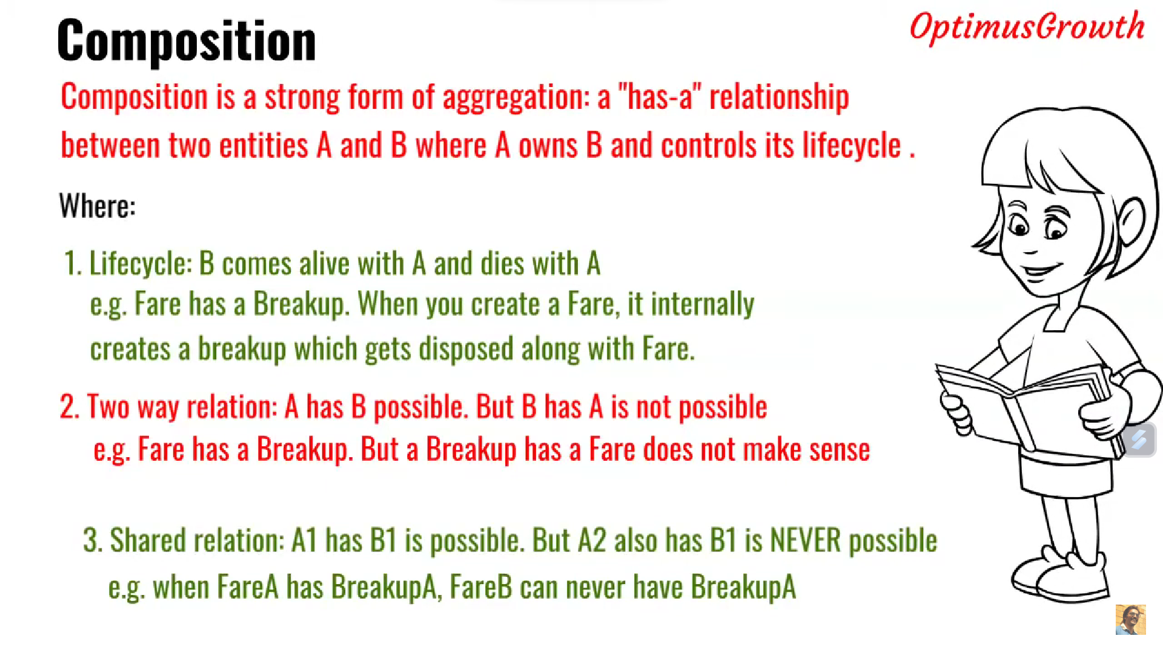
Open Close Principle: Open for extension closed for modification

Slide 25
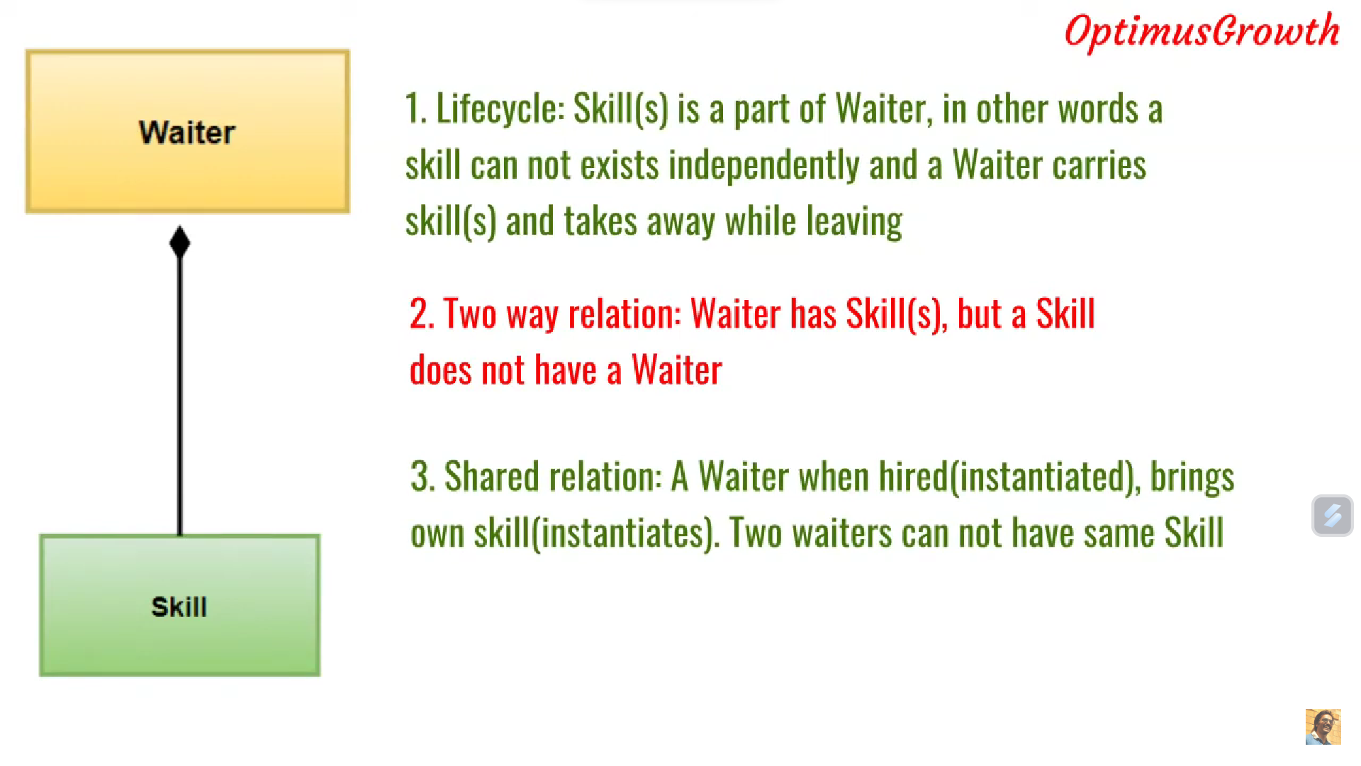
Open Close Principle: Open for extension closed for modification

Slide 26
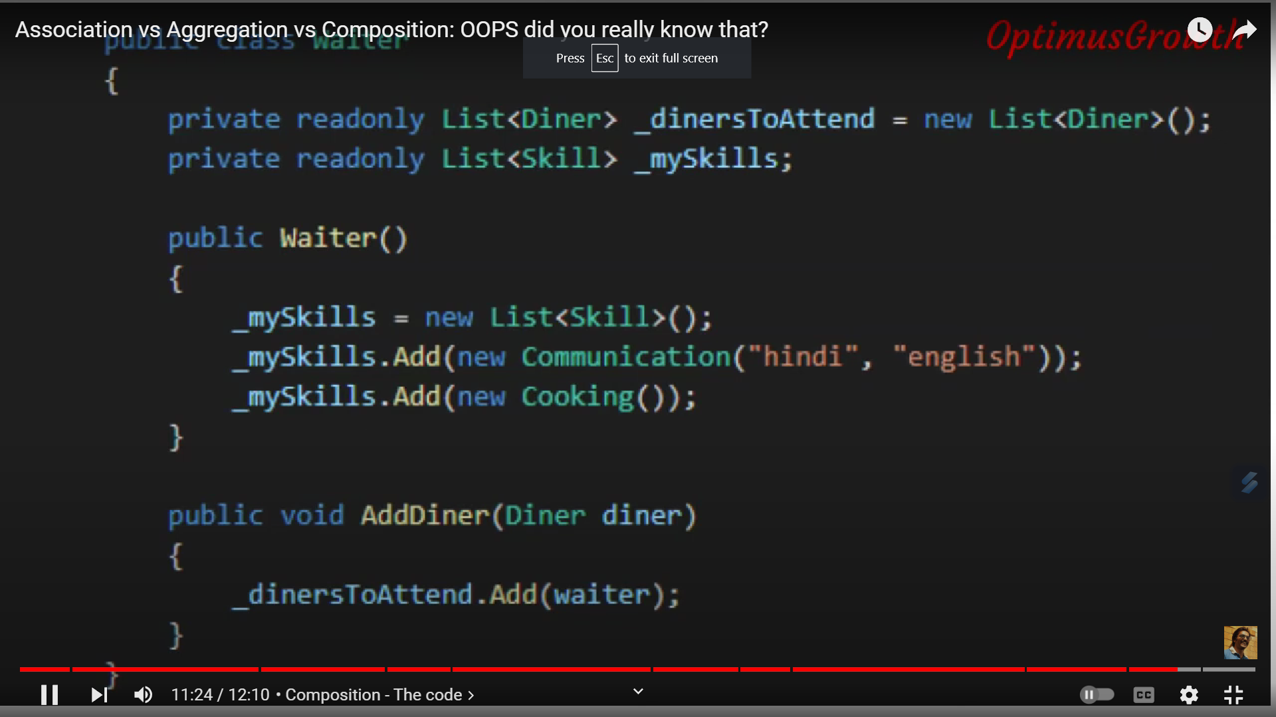
Open Close Principle: Open for extension closed for modification

Slide 27
https://www.youtube.com/watch?v=eGw36szrzjU

